Slide 1
The Magic Square 1514

Slide 2
Magic Square
A 500-year-old math secret…

Slide 3
Magic Square
The Dürer Magic Square

Slide 4
Magic Square
Created in 1514 by Albrecht Dürer.

Slide 5
The Grid Reveal
16 3 2 13
5 10 11 8
9 6 7 12
4 15 14 1

Slide 6
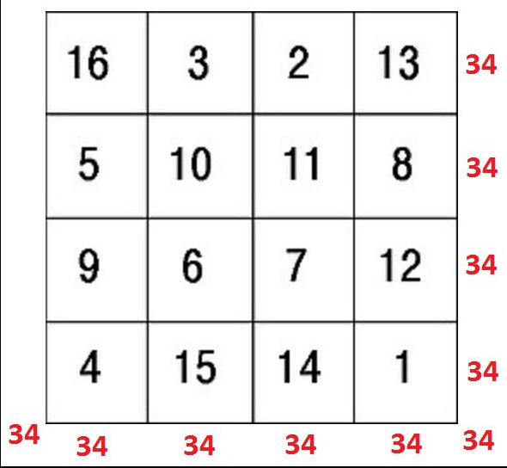
The Magic Number

Slide 7
1. Rows - Left → Right
16 + 3 + 2 + 13 = 34
5 + 10 + 11 + 8 = 34
9 + 6 + 7 + 12 = 34
4 + 15 + 14 + 1 = 34

Slide 8
2. Columns - Top ↓ Bottom
16 + 5 + 9 + 4 = 34
3 + 10 + 6 + 15 = 34
2 + 11 + 7 + 14 = 34
13 + 8 + 12 + 1 = 34

Slide 9
3. Diagonals -The magic lines
16 + 10 + 7 + 1 = 34
13 + 11 + 6 + 4 = 34

Slide 10
Bonus
Corners:
16 + 13 + 4 + 1 = 34
Center square:
10 + 11 + 6 + 7 = 34
Cross pattern:
3 + 5 + 12 + 14 = 34

Slide 11
Hidden Trick
4 15 14 1

Slide 12
Hidden Trick
1514 = Year of Creation

Slide 13
Why it Matters
“Math meets art. Order meets mystery.”

Slide 14
Summary
4×4 magic square
Constant sum = 34
Hidden 1514
Created by Dürer
Subscribe for more secrets.

